Slide 1
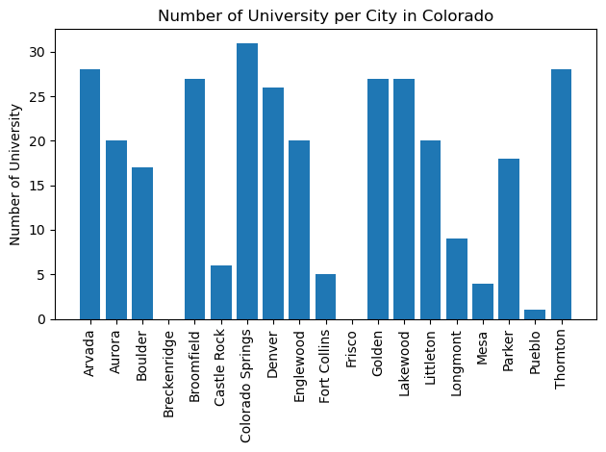
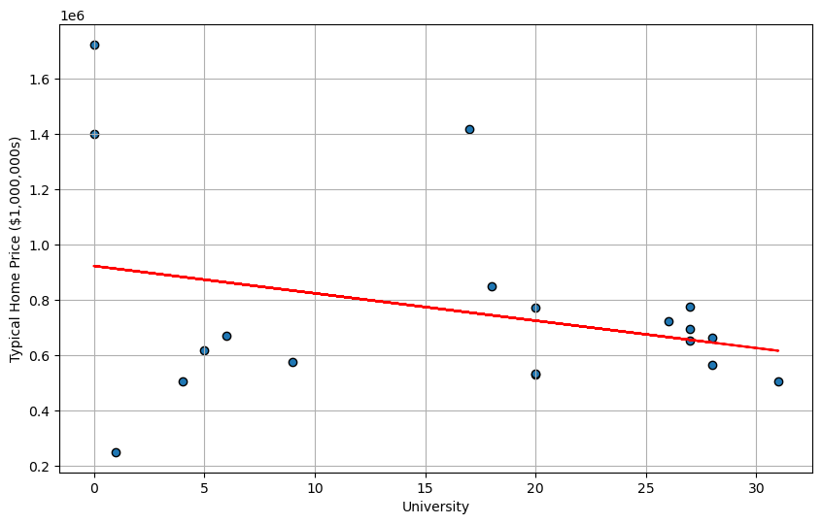

Slide 2
For my part of this group project, I used Geoapify to see if the presence of University increase home price in the state of Colorado.
Per the bar chart, Colorado Spring has 31 University vs Breckenridge and Frisco with zero.
Base on my finding, a strong demand for a good University nearby can drive property values higher.
I believe there are limitation to this dataset. In future project, I would expand my supported categories to “education.school” instead of limiting it to “education.university”
Also, it would be helpful to identify the homebuyers age, race/ethnicity, marital status and/or education.

